Slide 1
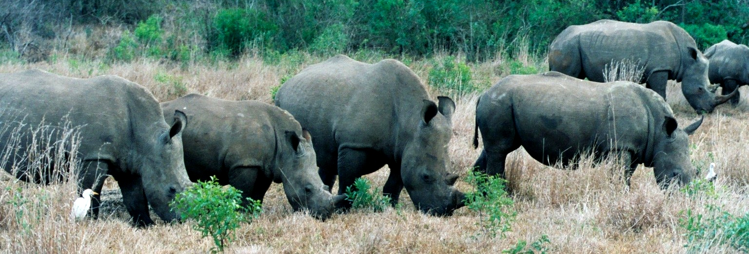
A Model for Community Beneficiation & Job Creation 31 March 2015

Slide 2
Introduction
&Beyond Phinda Private Game Reserve – A Case Study of Empowering Communities through Conservation/Wildlife & Tourism
Why has Land Restitution worked at Phinda?
Challenges
Way Forward

Slide 4
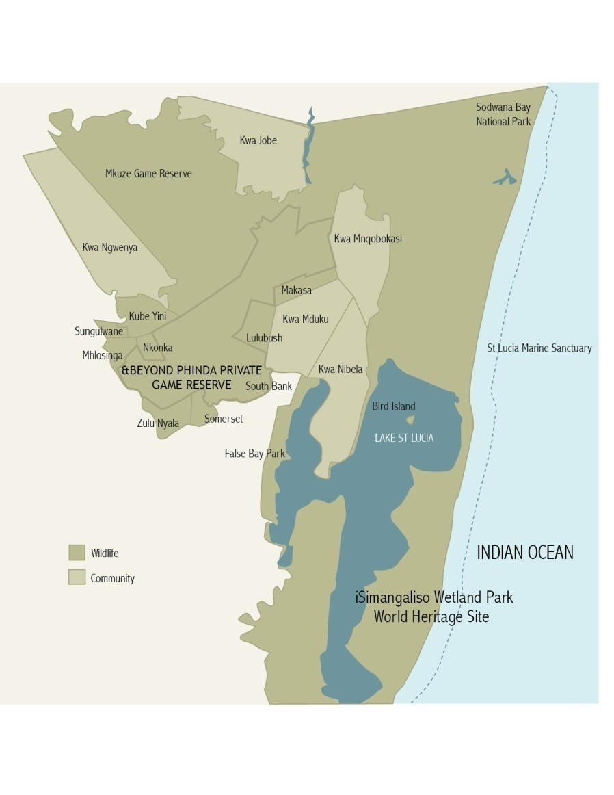
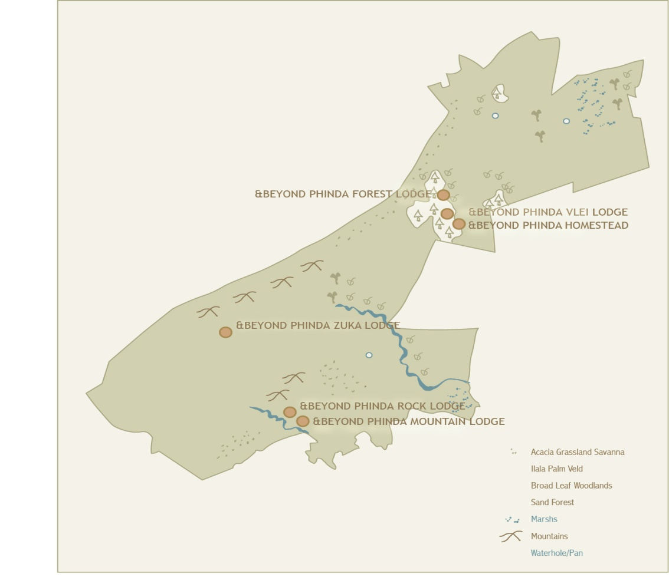
&Beyond Phinda
Location
Size
Lodges
USP’s
Cheetah
Sand Forest
Rhino
Diversity of habitats and species
Adventures & Indian Ocean
Zulu Culture
Biodiversity Assets

Slide 5
Phinda “The Return”
The Return - A Brief Conservation History
Story started 22 years ago
Reserve Objectives & Purpose
Tourism
Communities and Africa Foundation
Conservation
The Common Thread
Care of the Land, Wildlife & People
Luxury adventure travellers

Slide 6
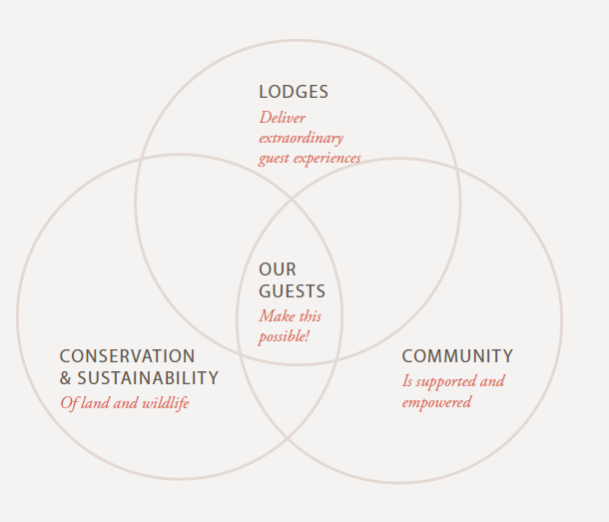
&Beyond Conservation Model DOING WELL BY DOING GOOD
“Care of the land, Care of the wildlife,
Care of the people.”
Our model for responsible travel is made up of three factors:
- Conservation
- Communities
- World class lodges & wildlife experience
Our goal is to “give more and take less” in everything that we do
It is the responsibility of each &Beyond staff member at every lodge to find ways to positively contribute to the earth

Slide 7
Pre 2006
Makhasa – 10 217ha total claim extent
Mnqobokazi - 11 509 ha total claim extent

Slide 9
The Phinda & SKS Estates Settled Claim
Mnqobokazi
Phinda Land 4966 ha
Makhasa
Phinda Land 4066 ha
SKS/Bumbeni 1523 ha

Slide 10
The Deal
Phinda Land
Transfer of Title Deeds/Ownership
Non occupation
&Beyond 36 year lease – first right of refusal for another 36 years
Excludes game
Over 200 beneficiaries each but for entire community
Monthly rental paid
Based on what business can afford
+R 150k per month each trust
Close to R 2 mil per year each
Projected over R 75 mil each Trust in 36 years
We are responsible for all improvement & maintenance of roads & infrastructure
Veld management
Preferential Employment
Skills development
Development Fund (MOA)
&Beyond R 9 mil each
Government R 40 mil each (yet to receive)
Trustee & beneficiary assistance
Lawyers
Investments
Accounting & financial management (budgets, book keeping, monthly accounts)
Advice
SARS & VAT reg
AGM’s
Trustee training
Trust deeds translated etc
Roles & responsibilities
Additonal Land at a lower rental
Bumbeni Land - Makhasa
?? Don’t know details

Slide 11
Makhasa/Shotton Land Inclusion
Claimed & settled with previous land owner
Community request to include in Munyawana/Phinda
Lease of 36 years agreed
Lease
2007
R 150 / ha per year
994.3 ha x R150 = R149 145/year
Up with CPI
Projected + R 6.5 million over 36 years
Game equalised – (R 500k) paid with Dev Fund R 9 mil
% share under Phinda in Conservancy

Slide 12
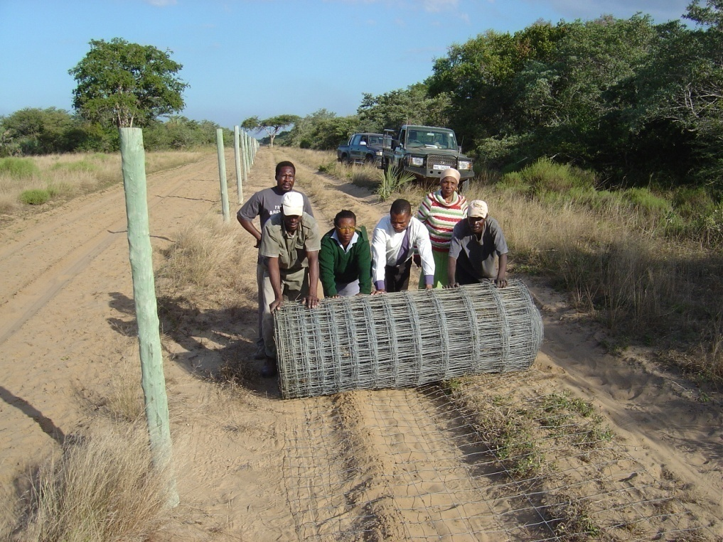
Mnqobokazi/Bischoffs Inclusion
Claimed & settled with previous land owner
Community request to include in Munyawana/Phinda
Lease of 36 years agreed
Lease
2008
R 150 / ha per year
1139.52 ha x R150 = R170 928/year
Up with CPI
Projected + R 7 million over 36 years
Game equalised – (R 500k) paid with Dev Fund R 9 mil
Fence Upgrade (R250k) paid with Dev Fund$
Conservation benefits
Cheetah
Allowed black rhino introduction
% share under Phinda in Conservancy

Slide 13
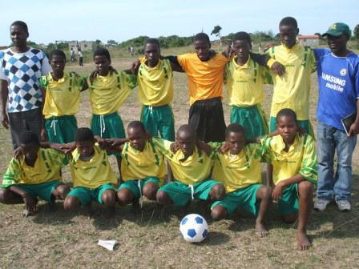
Spends
Phinda & SKS Lease payments
Electrification of houses
Bursary schemes
Fences
Tractors
Dam building & repairs
Small businesses
Beneficiary dividends/payouts
Training
Lawyers, Accountants & Investments
AGM’s
Infrastructure development
Community Centres
Air cons
Land surveyors & business development consultants
Sports Development
Development Fund (&Beyond donated)
Fencing
Purchase of game
Community Contracts
Road cutting
Alien Plant Eradication

Slide 14
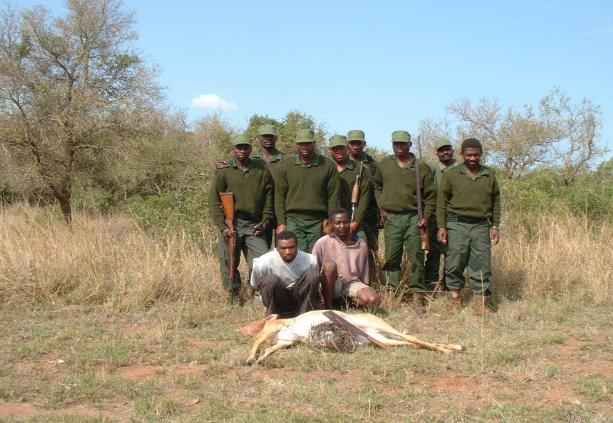
Other Community Benefits
Africa Foundation
Direct Employment
308 staff employed by &Beyond Phinda
Approx 200 from local communities
R20 million budgeted for Phinda payroll
Approx R13 million will go into local communities
Indirect Employment
Over 60 contract staff – security/canteen catering/staff transport/refuse removal/alien plant control (R500k)/entertainment/fencing
R3.5 million Security – 85% of staff from communities
1 person supports 10
Settlement of Land Claims
Makhasa Community Trusts – R 11,978,809
Mnqobokazi Community Trust – R10,901,292
Development Fund – R 9 million
Conservation Lessons

Slide 15
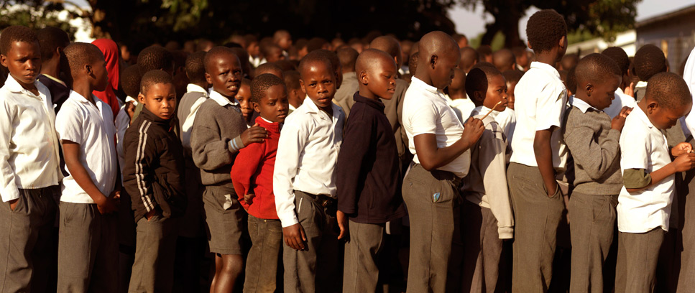
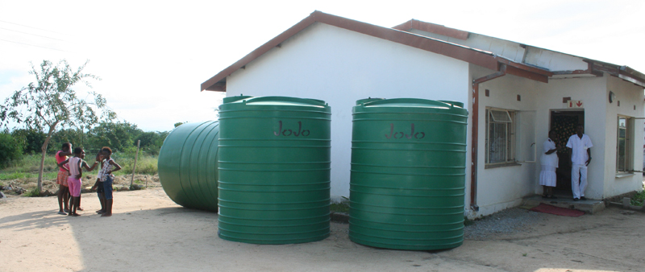
Africa Foundation Achievements since 2007
R 15 290 339 donated to Phinda Communities since 2007
166 Bursaries
2 Buses
24 Classrooms
1 Communal water fountain
7 Boreholes & water tanks at Schools
9 Water Pumps & Irrigation systems for community gardens
21 Schools received reticulation to link them to municipal main water line
1 Bakery
78 Conservation Lessons conducted, reaching 644 children & 78 teachers
3 Subsistence gardens upscaled to small commercial farms
12 Cottages - teachers accommodation 2 Administration Blocks
2 OVC Centres to support orphans and vulnerable children

Slide 16
Challenges
Attracting Guests & best wildlife experience
Fickle tourism market
Fluctuating rand
Perception of SA by International Market Changing (high end guests)
Ability to pay high fixed cost rentals if business is down
Tourism/wildlife business
Recession
Spiraling fixed costs – labour/power/water/security/food/fuel
Revenue flat
Rhino poaching
High competition – eco tourism market is saturated
Relationship with Community
Trust
Communication
Politics within community
New community structures
Growing community
Limited employment
Pressure on resources
Dilution of benefits from reserve community members
Changing perception of reserve – positive/negative
Expectations

Slide 17
Why is/has Land Restitution Worked
Trusting relationship with Community built up over many years
Win/win
Financial Benefits
Makhasa Community Trusts – R 11,978,809
Mnqobokazi Community Trust – R10,901,292
Development Fund – R 9 million each
Supported each other
Trust Chairman’s Role
Community Trust Financial planning & accountability
Communication

Slide 18
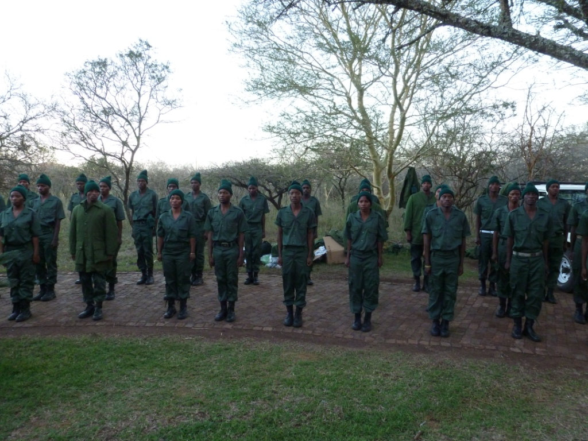
Way Forward
Keep delighting guests/best wildlife experience
Skills Development
Star in Training
Skills development & training
28 community members every year
Management & Leadership Development
Continue to assist Chairman’s/Trustees with roles & responsibilities if requested
Employment
Extended Public Works Programmes
WOF
WOW
Community Guards
Africa Foundation
Increase role and extend to other communities around Phinda
Environmental Education & school programs
Possible incorporation of new community owned land into Phinda/Munyawana
Greater conservation land
Employment
Boost local economy
Challenges & hurdles

Slide 19
Thank You
Simon Naylor
0832807345
Musa.mbatha@andbeyond.com
&Beyond Phinda Private Game Reserve
www.andbeyond.com
www.phinda.com
Africa Foundation
www.africafoundation.org.za
Mnqobokazi Trust
Jabulani Nxumalo (Chairman) – 0826885806
mjeynxumalo@ymail.com
www.mnqobokazict.com
Makhasa Community Trust
Thokozani Mlambo (Chairman) – 0835104445
thoksmlambo@gmail.com

